Slide 1
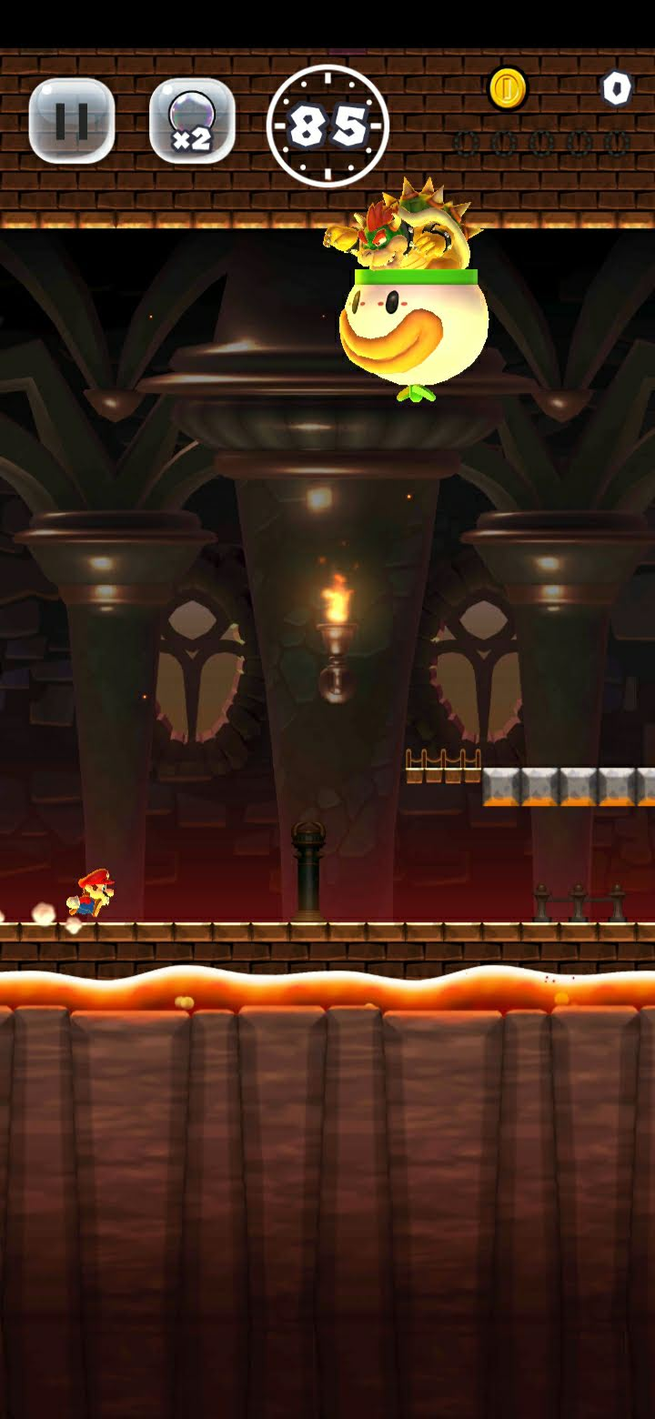
Phone: 720x1560 = 2.1, including top 10 px
Phone: 720x1510 = 2.09
Play Area: 720x1080=1.5

